Slide 2

EU wide registry of public sector semantic models
Raf Buyle, PhD
Digital Flanders - Belgium
athumi, the Flemish Data Utility Company
imec-IDLab Ghent University

Slide 3



Slide 4
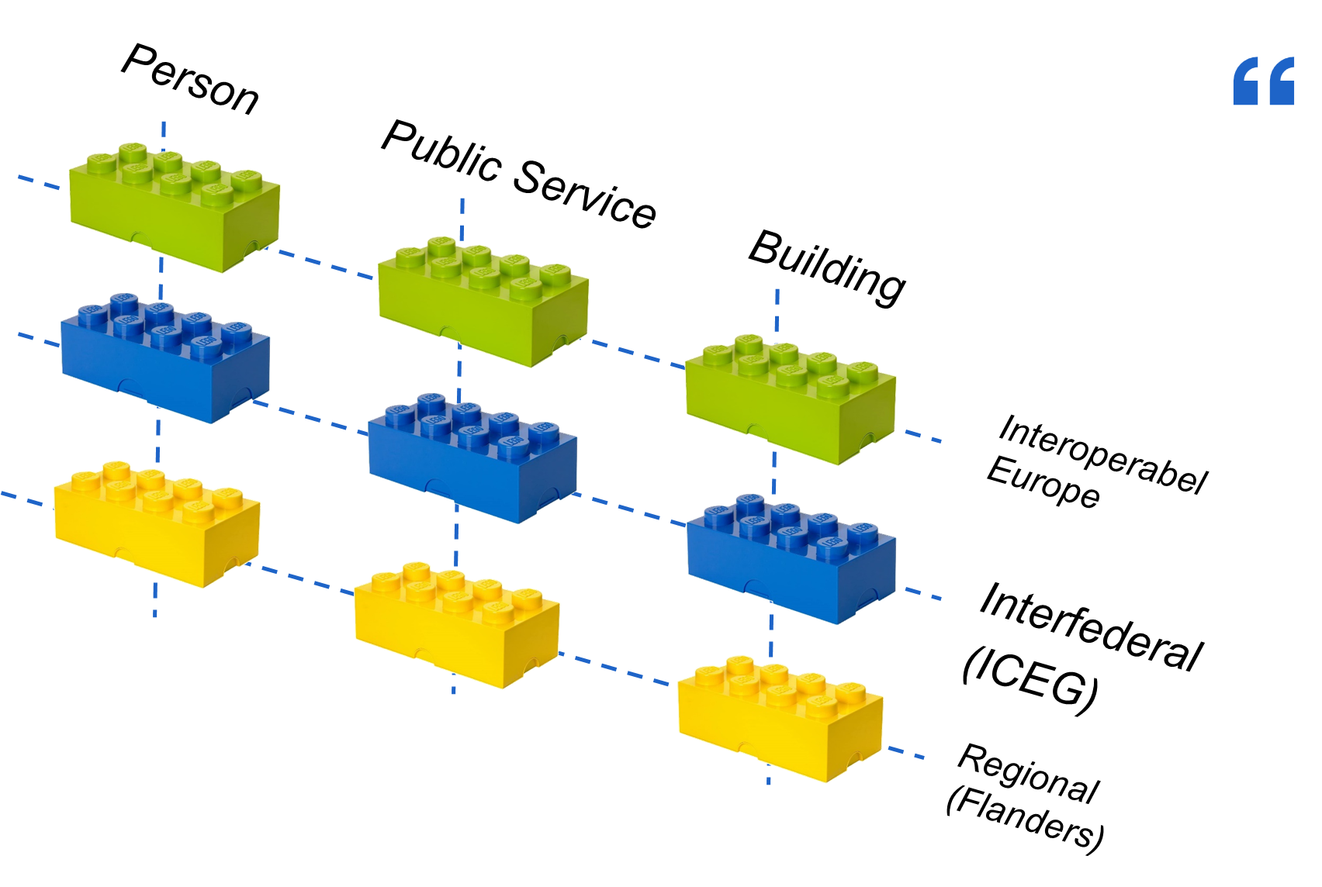






Local adoption of semantic assets
Interfederal (ICEG)
Regional
(Flanders)

Slide 5
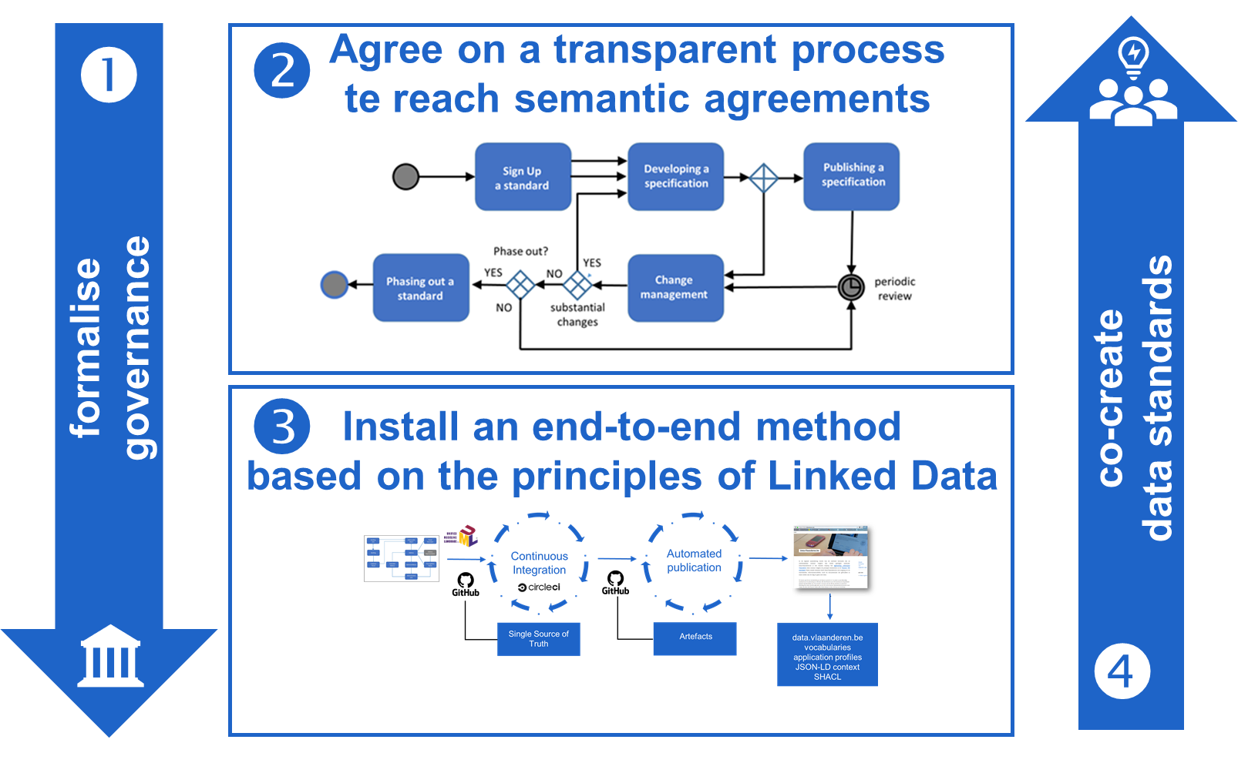
OSLO Process and method

Slide 6
Share and reuse
inspiration
adoption
contribution

Slide 7
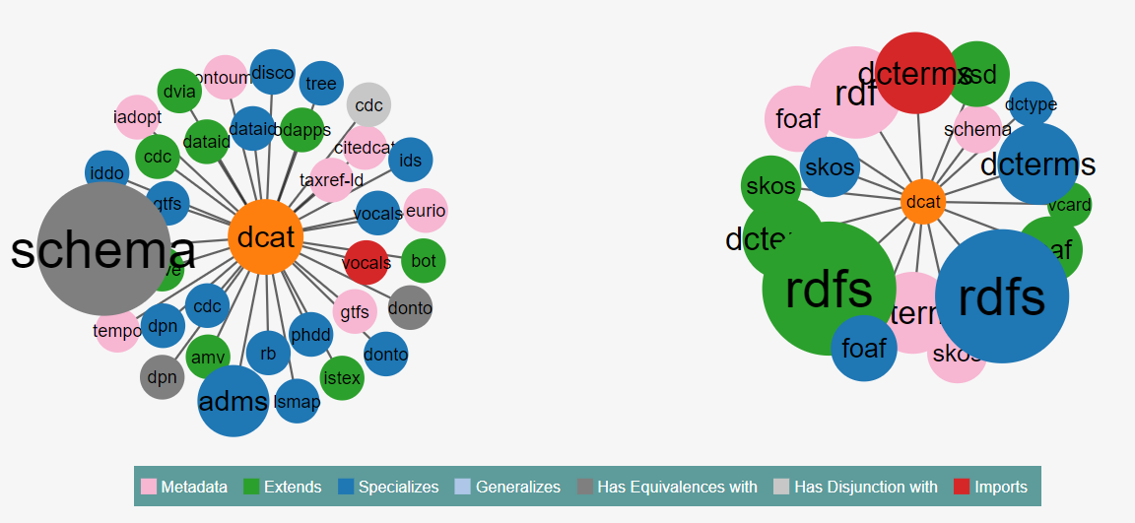
(i) Inspiration: EU wide semantic registry
34 Incoming Links
17 Outgoing Links

Slide 8
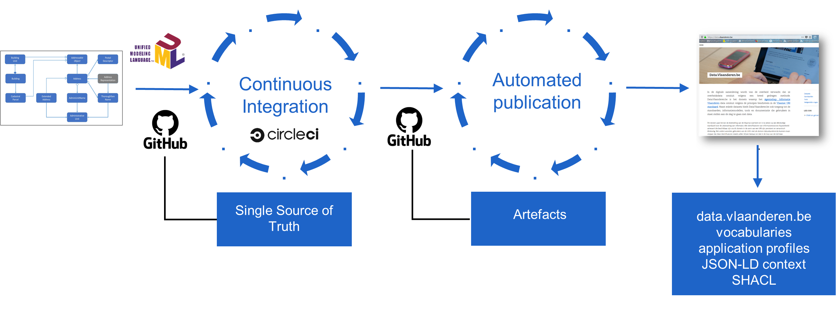
(ii) adoption: workbench to extend existing voc’s
EU semantic
registry

Slide 9
(iii) contribution: add your assets to the EU registry
Metadata portal
EU semantic
registry
Metadata portal
Metadata portal

Slide 10
Share and reuse³:
“implies a shared process (governance) and method (collaboration environment)”

Slide 11
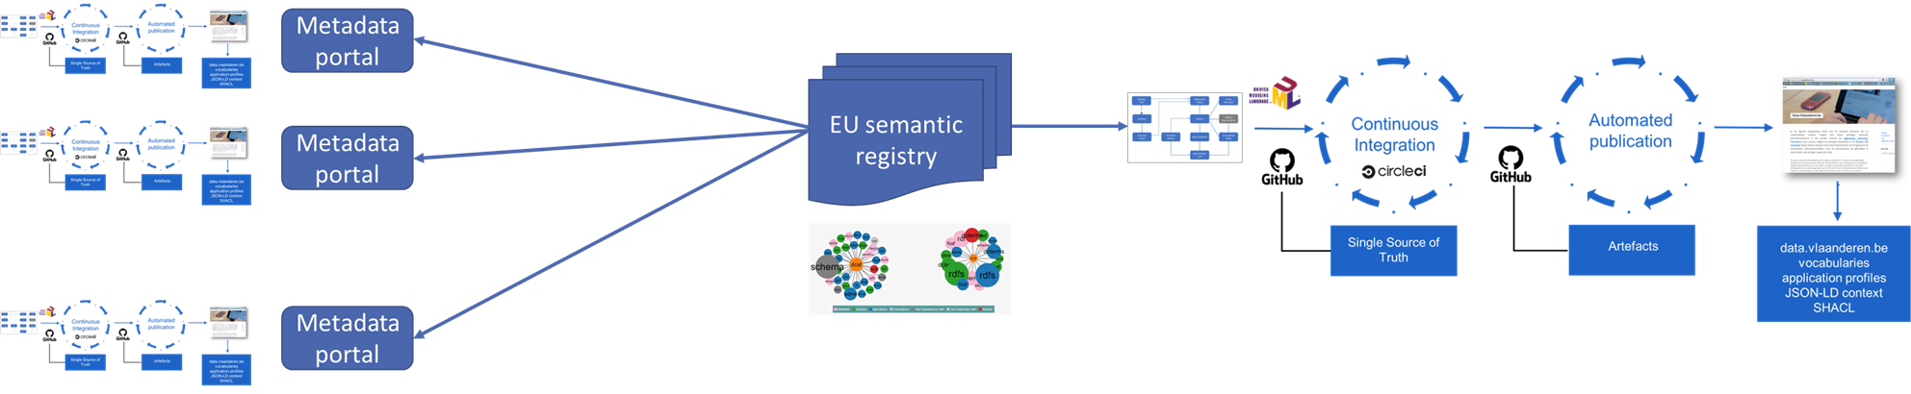
Share and reuse³
contribute
inspire
adopt

Slide 12


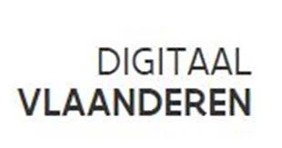



Looking forward to collaborate on EU wide registry of public sector semantic models
Raf Buyle, PhD
https://www.linkedin.com/in/rafbuyle/ @Rafke

